Slide 1
SCALE

Slide 2
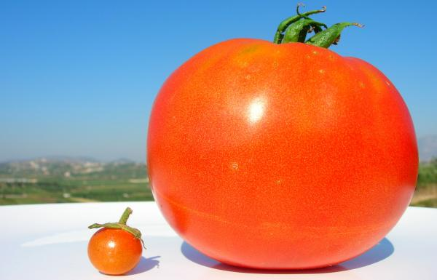
Scale
The relative size of elements in relation to each other

Slide 3
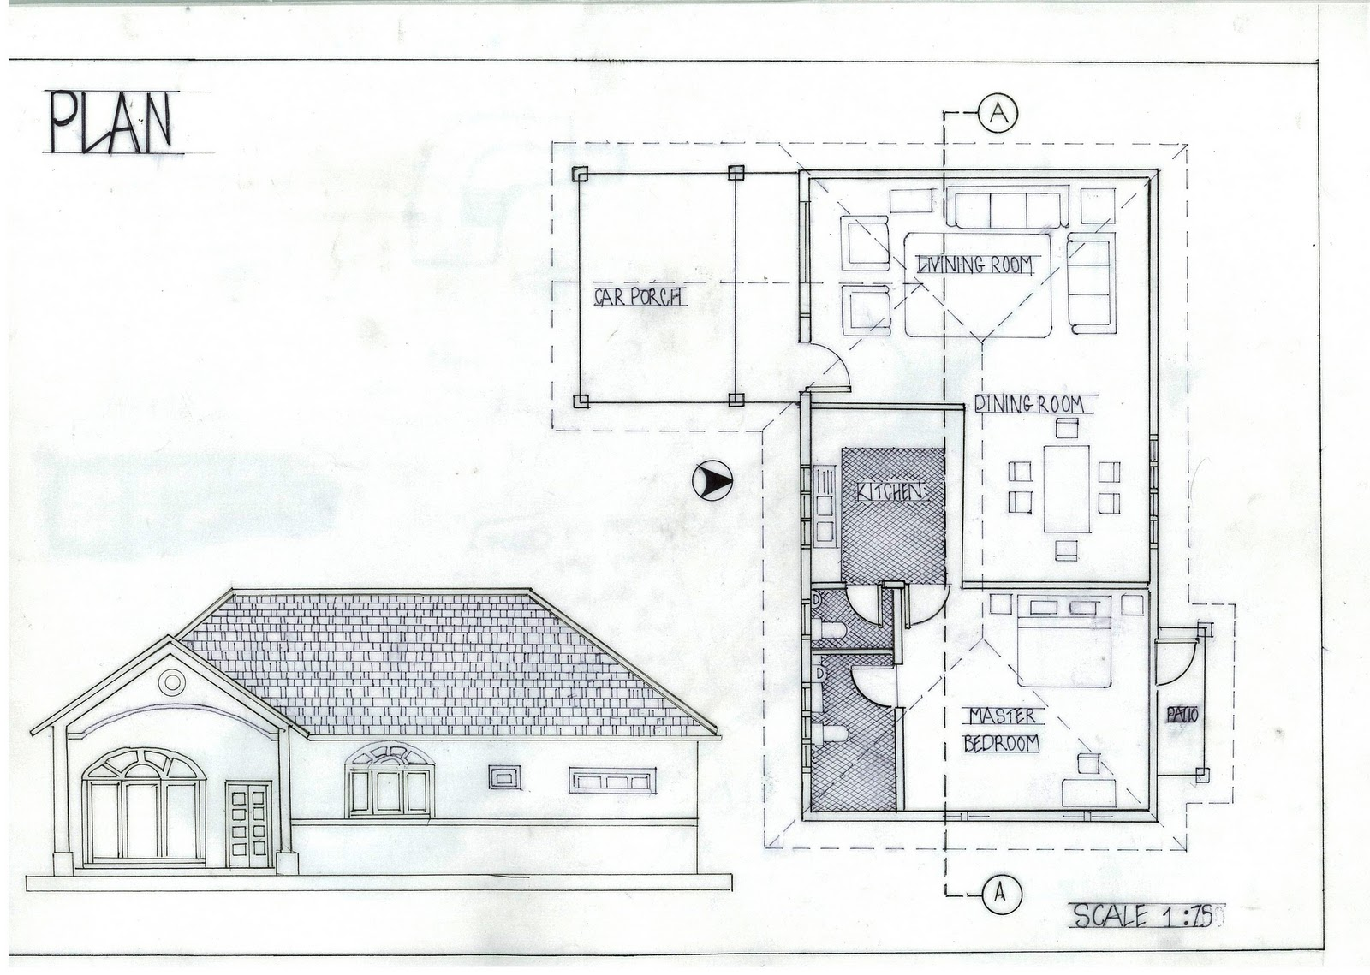
Scale model
In Architecture

Slide 4
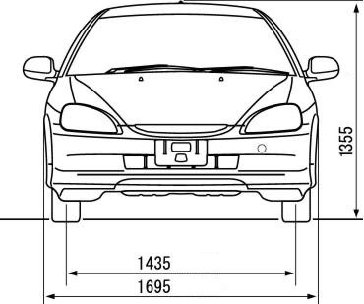
Scale model
In design

Slide 5
Large and Small scale

Slide 6
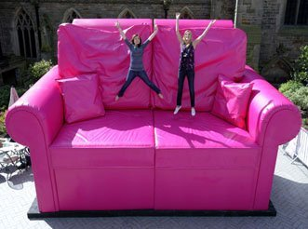
Dissimilar Scale
What do you think of?

Slide 7
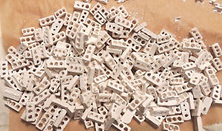
Different Viewpoint
Out of context scale

Slide 8
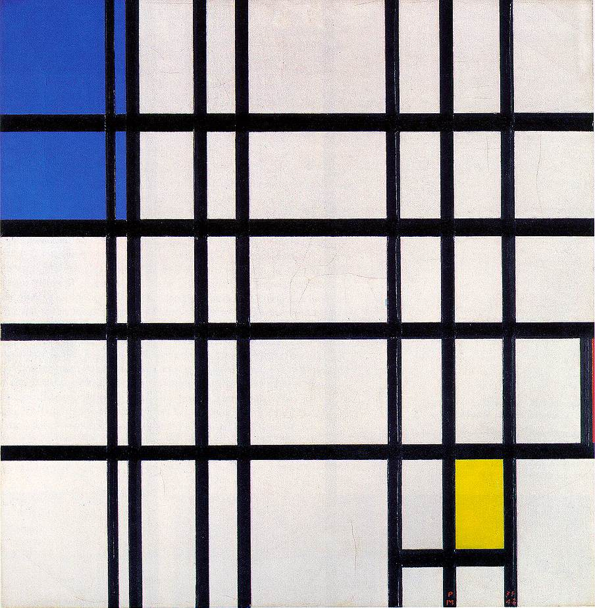
Proportion
The amount of visual weight given to relative elements in a composition

Slide 9
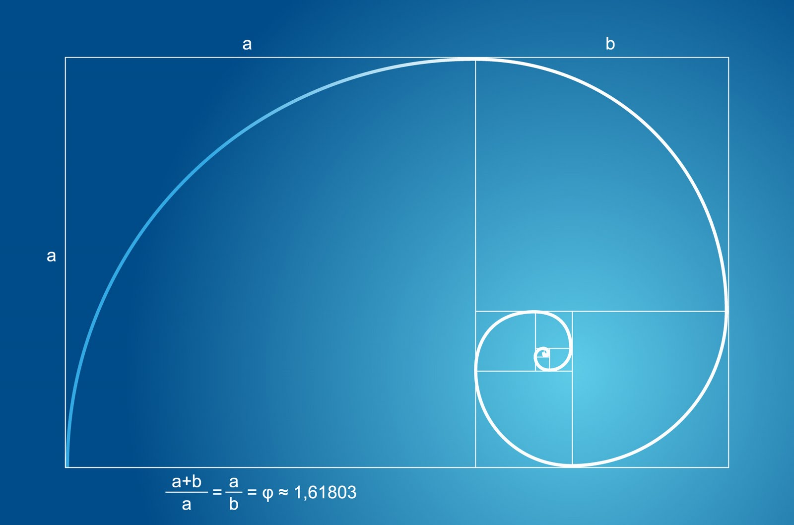
Golden Ratio
A system for design layout

Slide 10
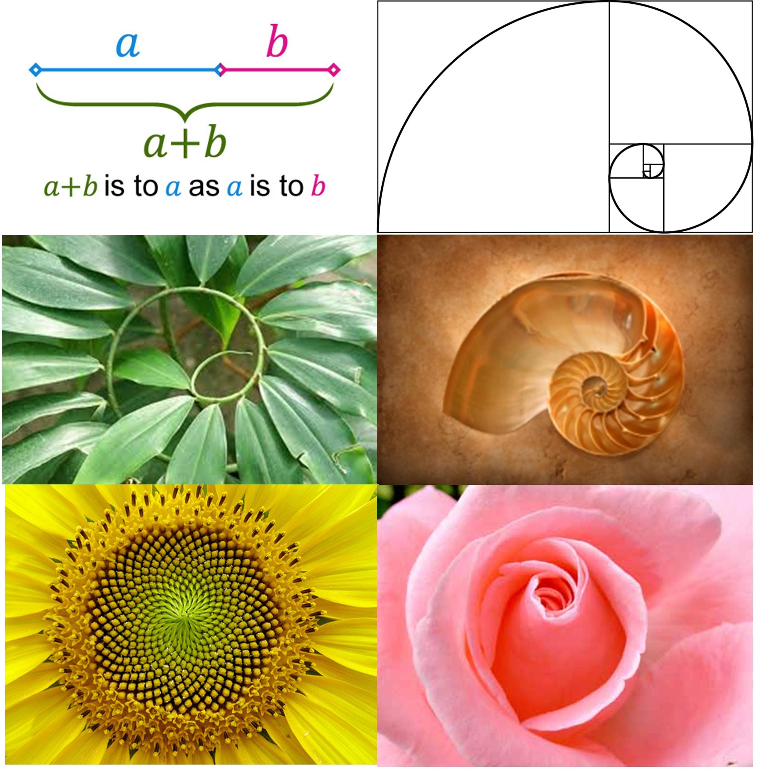
Golden ratio in nature

Slide 11
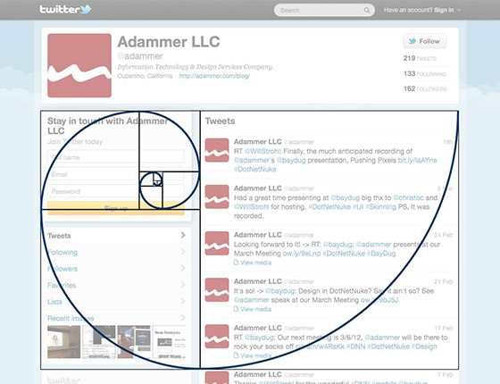
Golden Ration in Design
Website layout

Slide 12
Value Proportion

Slide 13
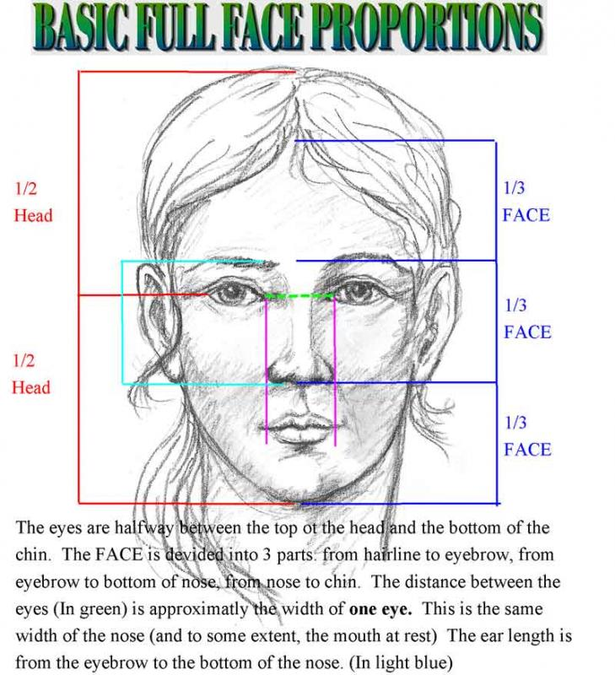
Facial Structure

Slide 14
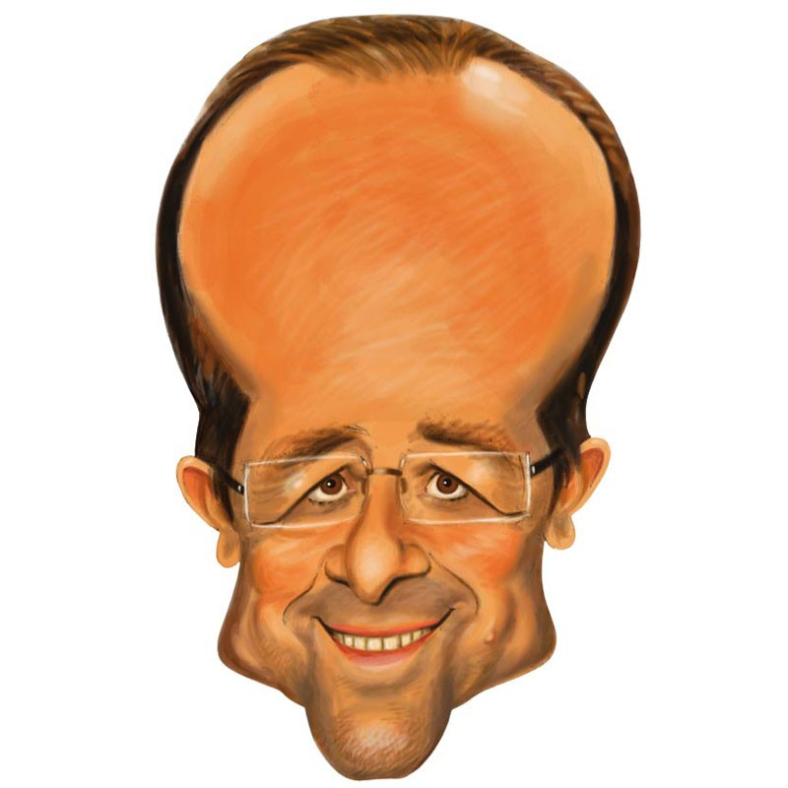
Disproportion
caricature

