Slide 1
MOVEMENT

Slide 2
MOVEMENT

Slide 3
Perspective and scale

Slide 4
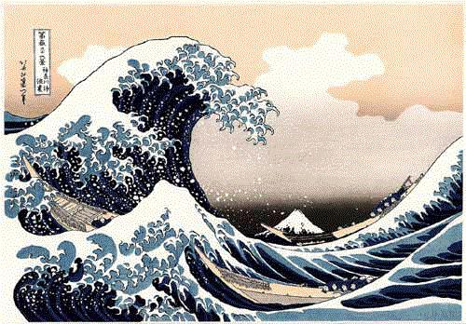
Potential Motion

Slide 5
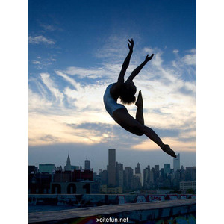
Potential Motion

Slide 6
Impending Motion

Slide 7
Illusion of sound

Slide 8
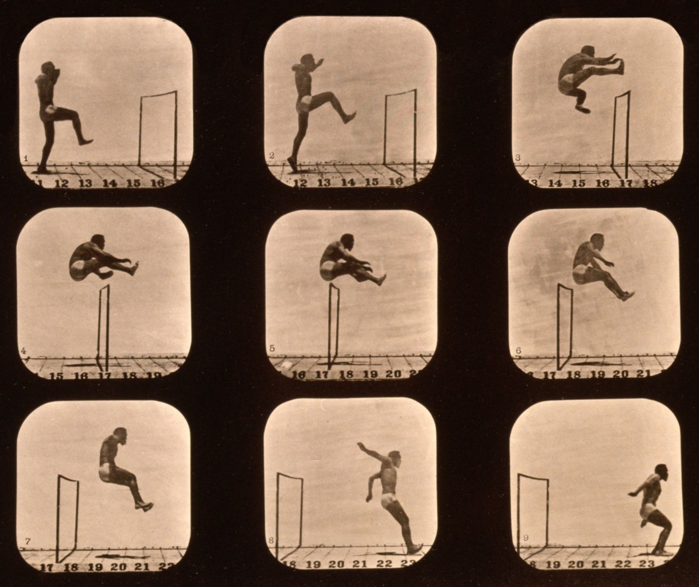
Progression of time

Slide 9
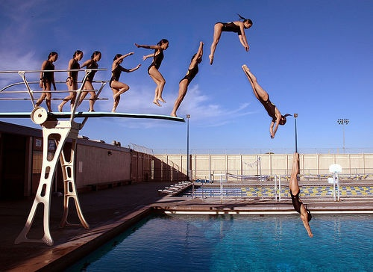
Time lapse

Slide 10
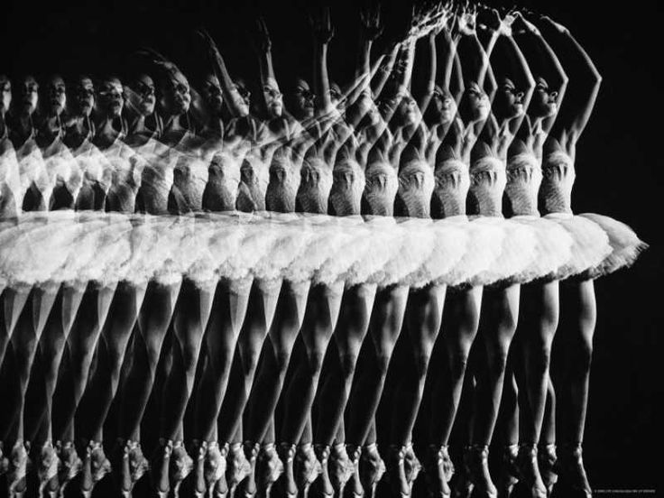
Stop motion

Slide 11
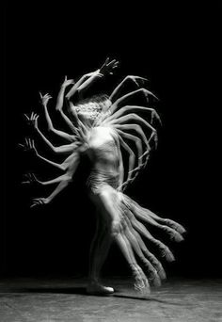
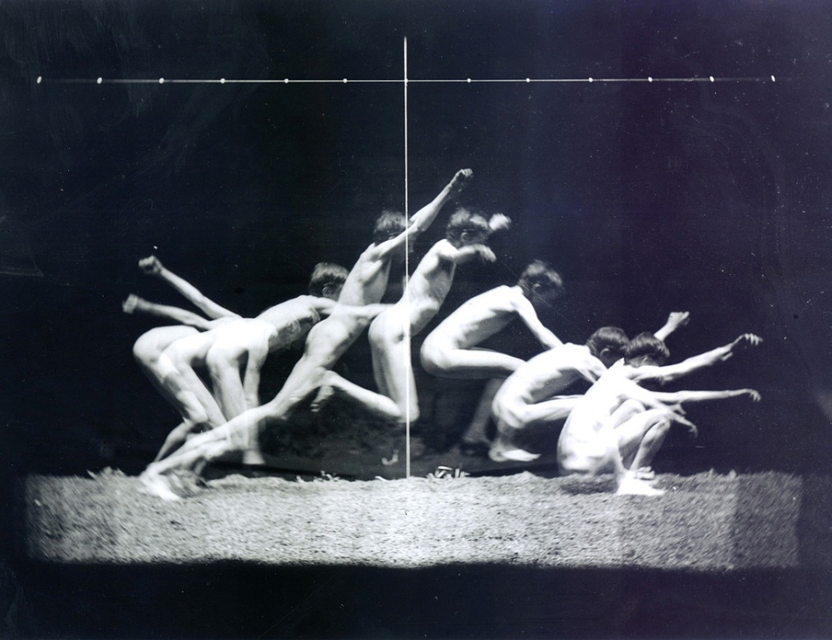
Stop motion
Edward Muybridge

Slide 12
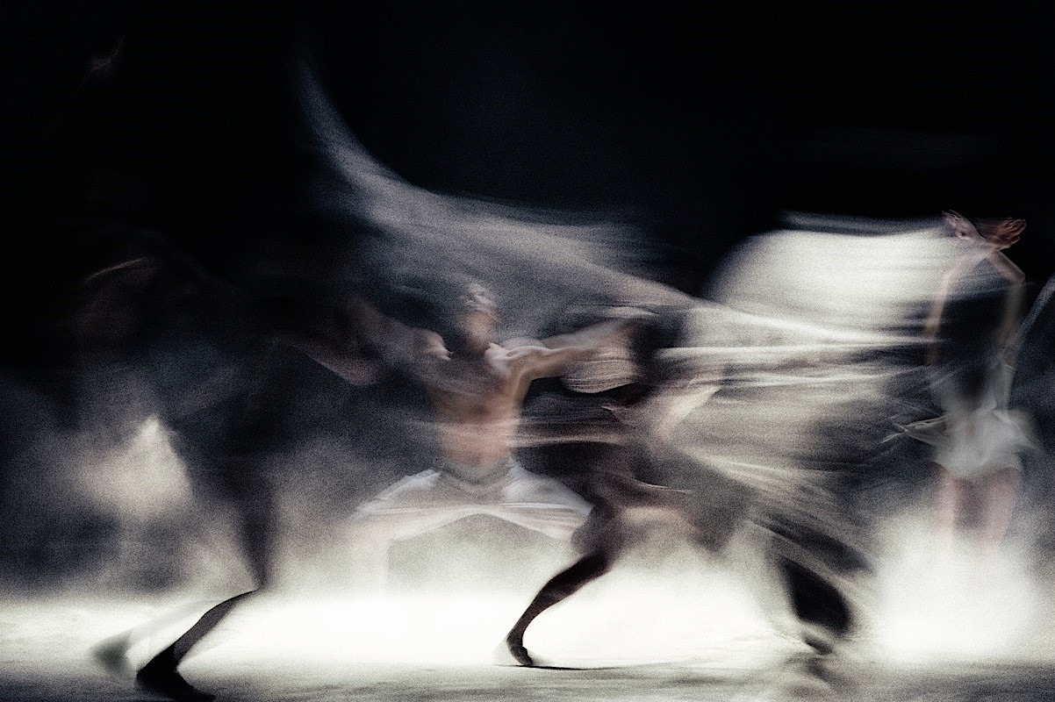
Blurred motion

Slide 13
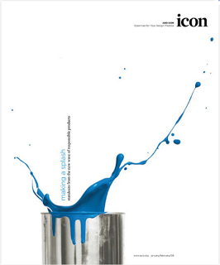
Action

Slide 14
Visual flow in space

Slide 15
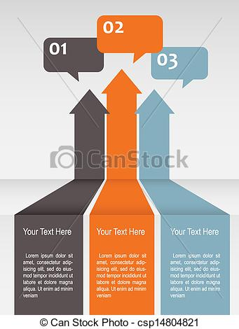
Visual flow from front to back

Slide 16
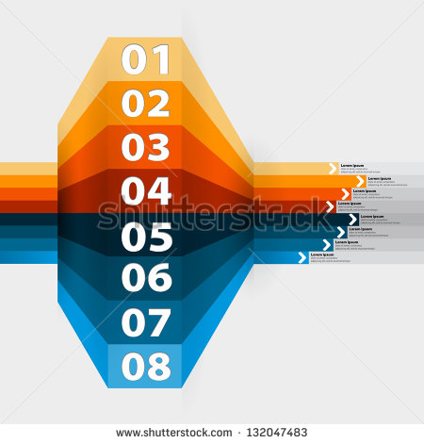
Visual flow

Slide 17
Showing distance

Slide 18
From one position to another

Slide 19
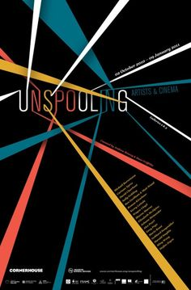
With directional lines

